Slide 1
CS 335: Introduction to Large Language Models
Modeling
Week
Dr Abdul Samad

Slide 2
Lecture Outline
NLP
Word Embedding
Encoder
Decoder
Huggingface

Slide 3
NLP
The following is a list of common NLP tasks, with some examples of each:
Classifying whole sentences: Getting the sentiment of a review, detecting if an email is spam, determining if a sentence is grammatically correct or whether two sentences are logically related or not
Classifying each word in a sentence: Identifying the grammatical components of a sentence (noun, verb, adjective), or the named entities (person, location, organization)
Generating text content: Completing a prompt with auto-generated text, filling in the blanks in a text with masked words
Extracting an answer from a text: Given a question and a context, extracting the answer to the question based on the information provided in the context

Slide 4
Word-Embeddings
Humans speak in words and sentences, but computers only understand and process numbers. How can we turn words and sentences into numbers in a coherent way? An assignment of words to numbers is called a word embedding.
https://txt.cohere.com/sentence-word-embeddings/
https://www.cs.cmu.edu/~dst/WordEmbeddingDemo/

Slide 5
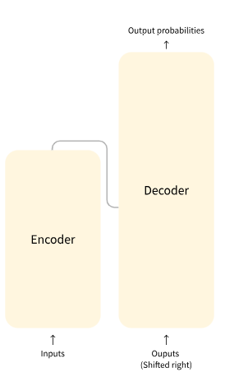
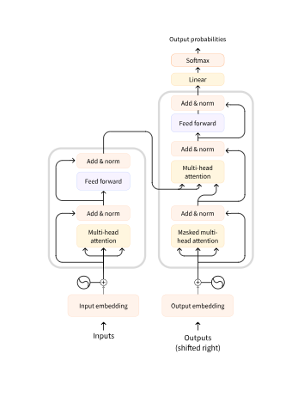
Attention is all you need

Slide 6
Encoder-Decoder
Encoder : The encoder receives an input and builds a representation of it (its features). This means that the model is optimized to acquire understanding from the input.
Decoder : The decoder uses the encoder’s representation (features) along with other inputs to generate a target sequence. This means that the model is optimized for generating outputs.

Slide 7
Encoder-Decoder
Encoder-only models: Good for tasks that require understanding of the input, such as sentence classification and named entity recognition.
Decoder-only models: Good for generative tasks such as text generation.
Encoder-decoder models or sequence-to-sequence models: Good for generative tasks that require an input, such as translation or summarization.

Slide 8
Encoders
How do they work?

Slide 9
0.1, 0.2, …
0.3, 0.1, …
0.2, 0.3, …
Encoder
welcome
to
NYC
The encoder outputs a numerical representation for each word used as input

Slide 10
Numerical Representation
0.1, 0.2, …
0.3, 0.1, …
0.2, 0.3, …
Sequence of numbers
Encoder
welcome
to
NYC
The encoder outputs a numerical representation for each word used as input

Slide 11
0.2
0.4
0.1
-
-
-
-
-
-
0.3
0.1
0.5
Welcome
to
NYC
This representation is made up of a vector of values for each word of the initial sequence

Slide 12
0.2
0.4
0.1
-
-
-
-
-
-
0.3
0.1
0.5
Welcome
to
NYC
Each word in the initial sequence affects every word’s representation

Slide 13
0.2
0.4
0.1
-
-
-
-
-
-
0.3
0.1
0.5
Welcome
to
NYC
This is thanks to self-attention mechanism

Slide 14
Why would one use an encoder?
Good at extracting meaningful information
Sequence classification, question answering, masked language modelling
NLU: Natural Language Understanding
Example of encoders: BERT, RoBERTa, ALBERT

Slide 15
Masked Language Modelling
Guessing a randomly masked word
My
???
is
Samad
.
name
Encoders with their bi-directional context, are good at guessing words in the middle of a sequence

Slide 16
Masked Language Modelling
Guessing a randomly masked word
My
???
is
Samad
.
??
name
School
This requires a semantic understanding as well as a syntactic understanding

Slide 17
Sentiment Analysis
Analyze the sentiment of a sequence
Even though I am sad to see them go, I couldn’t be more grateful
Positive
I am sad to see them go, I can’t be grateful
Negative
Encoders are good at obtaining an understanding of sequences; and the relationship/interdependence between words

Slide 18
Decoders
How do they work?

Slide 19
0.1, 0.2, …
0.3, 0.1, …
0.2, 0.3, …
Decoder
welcome
to
NYC
The decoder creates a feature tensor from an initial sequence

Slide 20
Numerical Representation
0.1, 0.2, …
0.3, 0.1, …
0.2, 0.3, …
Decoder
welcome
to
NYC
The decoder outputs numerical representation from an initial sequence

Slide 21
0.2
0.4
0.1
-
-
-
-
-
-
0.3
0.1
0.5
Welcome
to
NYC
The feature tensor is made up of a vector of values for each word of the initial sequence

Slide 22
0.2
0.4
0.1
-
-
-
-
-
-
0.3
0.1
0.5
Welcome
to
NYC
Words can only see the words on their left side; the right side is hidden

Slide 23
When should I use a decoder?
Unidirectional: access to their left (or right!) context
Great at causal tasks; generating sequences
NLG: Natural Language generation
Example of decoders: GPT-2, GPT Neo

Slide 24
Causal Language Modelling
Guessing the next word in a sentence
My
name
Decoders, with their uni-directional context, are good at generating words given a context

Slide 25
Causal Language Modelling
Guessing the next word in a sentence
My
name
My
name
is
Decoders, with their uni-directional context, are good at generating words given a context

Slide 26
Causal Language Modelling
Guessing the next word in a sentence
My
name
My
name
is
My
name
is
Sylvain
Decoders, with their uni-directional context, are good at generating words given a context

Slide 27
Causal Language Modelling
Guessing the next word in a sentence
My
name
My
name
is
My
name
is
Sylvain
My
name
is
Sylvain
.
Decoders, with their uni-directional context, are good at generating words given a context

Slide 28
Encoders-decoders
How do they work?

Slide 29
Output Probabilities
Decoder
Encoder
Inputs
Outputs
(Shifted right)
Let’s dive in the encoder-decoder!

Slide 30
0.1, 0.2, …
0.3, 0.1, …
0.2, 0.3, …
Encoder
Decoder
welcome
to
NYC
That representation is now used as an input for the decoder

Slide 31
0.1, 0.2, …
0.3, 0.1, …
0.2, 0.3, …
Encoder
Decoder
welcome
to
NYC
Start of sequence of words
That representation is now used as an input for the decoder

Slide 32
0.1, 0.2, …
0.3, 0.1, …
0.2, 0.3, …
WORD_1
Encoder
Decoder
welcome
to
NYC
Start of sequence of words
Using this representation and a prompt as input, the decoder generates a word

Slide 33
0.1, 0.2, …
0.3, 0.1, …
0.2, 0.3, …
WORD_1
WORD_2
Encoder
Decoder
welcome
to
NYC
Start of sequence of words
WORD_1
It then uses a combination of the representation and the word it just generated to generate a second word

Slide 34
0.1, 0.2, …
0.3, 0.1, …
0.2, 0.3, …
WORD_1
WORD_2
WORD_3
Encoder
Decoder
welcome
to
NYC
Start of sequence of words
WORD_1
WORD_2
And a third!

Slide 35
0.1, 0.2, …
0.3, 0.1, …
0.2, 0.3, …
Encoder
Decoder
welcome
to
NYC
Start of sequence of words
Let’s go over it one more time using translation as an example

Slide 36
0.1, 0.2, …
0.3, 0.1, …
0.2, 0.3, …
Bienvenue
à
Encoder
Decoder
welcome
to
NYC
Start of sequence of words
Bienvenue
Using this representation and the first word, “Bienvenue”, it is able to generate the second word: “à”

Slide 37
0.1, 0.2, …
0.3, 0.1, …
0.2, 0.3, …
Bienvenue
à
Encoder
Decoder
welcome
to
NYC
Start of sequence of words
Bienvenue
Using this representation and the first word, “Bienvenue”, it is able to generate the second word: “à”

Slide 38
0.1, 0.2, …
0.3, 0.1, …
0.2, 0.3, …
Bienvenue
à
NYC
Encoder
Decoder
welcome
to
NYC
Start of sequence of words
Bienvenue
à
And, finally, leveraging both the encoder output and the two initial words, it can generate the third one: “NYC”

Slide 39
Encoder
Decoder
The encoder-decoder is interesting due to the separation between its two components

Slide 40
Encoder
Decoder
The encoder takes care of understanding the sequence

Slide 41
Encoder
Decoder
The decoder takes care of generating a sequence according to the understanding of the encoder

Slide 42
When should I use a sequence-to-sequence model?
Sequence to sequence tasks; many-to-many : translation, summarization
Weights are not necessarily shared across the encoder and decoder
Input distribution different from output distribution

Slide 43
Sequence to Sequence
Transformers
are
powerful
Les
Transformers
sont
puissants
Translation
Output length is independent of input length in encoder-decoder models

Slide 44
Sequence to Sequence
Transformers (formerly known as pytorch-transformers and pytorch-pretrained-bert) provides general purpose architectures (BERT, GPT-2, RoBERTa, XLM, DistilBert, XLNet…) for natural language understanding (NLU) and natural language generation (NLG) with over 32+ pretrained models in 100+ languages and deep interoperability between TensorFlow 2.0 and PyTorch.
Transformers provides general purpose architectures for natural language understanding (NLU) and natural language generation (NLG)
Summarization
Sequence to Sequence language models handle variable output lengths

Slide 45
Sequence to Sequence
BART
ProphetNet
mT5
M2M100
T5
Pegasus
MarianMT
mBART
… and many others!
BERT
encoder
BERT
encoder
RoBERTa
encoder
GPT-2
decoder
BERT
decoder
RoBERTa
decoder
Sequence-to-Sequence models can be built from separate encoders and decoders

Slide 46
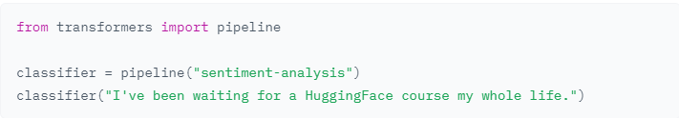
HuggingFace
The most basic object in the 🤗 Transformers library is the pipeline() function. It connects a model with its necessary preprocessing and postprocessing steps, allowing us to directly input any text and get an intelligible answer:

Slide 47
References
https://txt.cohere.com/sentence-word-embeddings/
https://www.cs.cmu.edu/~dst/WordEmbeddingDemo/
https://huggingface.co/

